Slide 1
Group 1 Review of Group 12
Members of Group 12:
Rajeshwari Ravi
Naresh Kumar
Christopher Scheller
Their Project is inspired by TROLLO

Slide 2
Something interesting about their project.
They used database

Slide 3
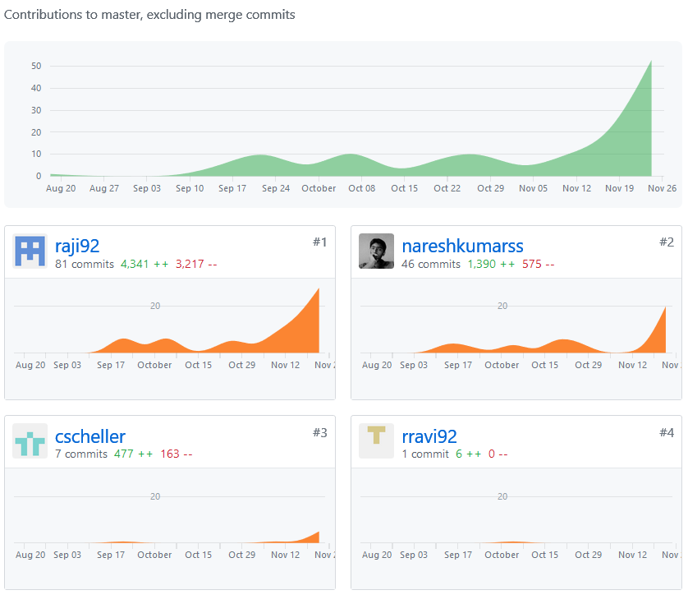
Graph of Their Combine Total Contribution to Master
Rajeshwari Ravi
Naresh Kumar
81 commits with 4341 ++
46 commits with 1390 ++
Christopher Scheller
7 commits with 477 ++

